Slide 1
Machine Learning
Machine Learning Introduction to Machine Learning by Kumar Anurupam is licensed under a Creative Commons Attribution-4.0 International License.
SVM Kernels
CS 3104 Fall 2019
Lecture Slides by Kumar Anurupam

Slide 2
Learning Objectives
After completion of today’s session you will be able to:
Explain the dual form of linear SVM function.
Describe SVM kernels.

Slide 3
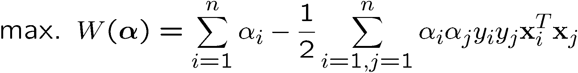
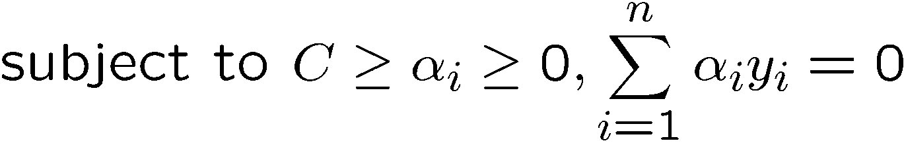
The Optimization Problem
α’s → New variables
(Lagrangian multipliers)
The dual of the problem is
w is also recovered as
The only difference with the linear separable case is that there is an upper bound C on α_{i}
We don’t need to compute w explicitly for classification:
w = Σα_{i}y_{i}x_{i}
f(x) = Σα_{i}y_{i}x_{i}^{T}x + b
Notes:
Note also, everything is done by inner-products

Slide 4


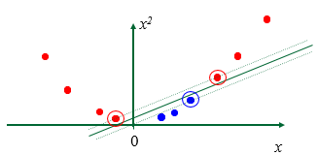
Non linear SVM
Datasets that are linearly separable with some noise work out great:
But what are we going to do if the dataset is just too hard?
How about… mapping data to a higher-dimensional space:

Slide 5
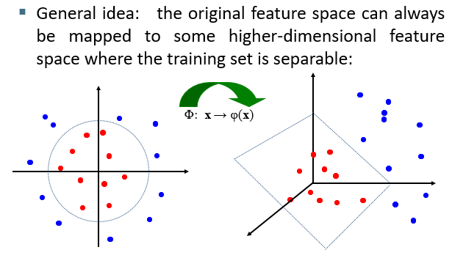
Non – lInear SVM’s: feature spaces

Slide 6
SVM kernel functions
SVM algorithms use a set of mathematical functions that are defined as the kernel. The function of kernel is to take data as input and transform it into the required form.
Different SVM algorithms use different types of kernel functions. These functions can be different types. For example linear, nonlinear, polynomial, radial basis function (RBF), and sigmoid.
Introduce Kernel functions for sequence data, graphs, text, images, as well as vectors. The most used type of kernel function is RBF.
The kernel functions return the inner product between two points in a suitable feature space. Thus by defining a notion of similarity, with little computational cost even in very high-dimensional spaces.

Slide 7

Examples of kernel functions
Polynomial kernel with degree d
Radial basis function kernel with width σ
Closely related to radial basis function neural networks
The feature space is infinite-dimensional
Sigmoid with parameter κ and θ
It does not satisfy the Mercer condition on all κ and θ

Slide 8
Choosing the kernel function
Probably the most tricky part of using SVM.
The kernel function is important because it creates the kernel matrix, which summarizes all the data
Many principles have been proposed (diffusion kernel, Fisher kernel, string kernel, …)
There is even research to estimate the kernel matrix from available information
In practice, a low degree polynomial kernel or RBF kernel with a reasonable width is a good initial try.
Note that SVM with RBF kernel is closely related to RBF neural networks, with the centers of the radial basis functions automatically chosen for SVM

Slide 9
Strengths of SVM
Training is relatively easy
We don’t have to deal with local minimum like in ANN
SVM solution is always global and unique (check “Burges” paper for proof and justification).
Unlike ANN, doesn’t suffer from “curse of dimensionality”.
How? Why? We have infinite dimensions?!
Less prone to overfitting
Simple, easy to understand geometric interpretation.
No large networks to mess around with.

Slide 10
Weaknesses of SVM
Training (and Testing) is quite slow compared to ANN
Essentially a binary classifier
However, there are some tricks to evade this.
Very sensitive to noise
A few off data points can completely throw off the algorithm
Biggest Drawback: The choice of Kernel function.
There is no “set-in-stone” theory for choosing a kernel function for any given problem (still in research...)
Once a kernel function is chosen, there is only ONE modifiable parameter, the error penalty C.

Slide 11
References
Adapted from the lecture slides by Carla P. Gomes gomes@cs.cornell.edu, Module:SVM
Christopher J. C. Burges. 1998. A Tutorial on Support Vector Machines for Pattern Recognition
S. T. Dumais. 1998. Using SVMs for text categorization, IEEE Intelligent Systems, 13(4)
S. T. Dumais, J. Platt, D. Heckerman and M. Sahami. 1998. Inductive learning algorithms and representations for text categorization. CIKM ’98, pp. 148-155.
Yiming Yang, Xin Liu. 1999. A re-examination of text categorization methods. 22nd Annual International SIGIR
Tong Zhang, Frank J. Oles. 2001. Text Categorization Based on Regularized Linear Classification Methods. Information Retrieval 4(1): 5-31
Trevor Hastie, Robert Tibshirani and Jerome Friedman. Elements of Statistical Learning: Data Mining, Inference and Prediction. Springer-Verlag, New York.
T. Joachims, Learning to Classify Text using Support Vector Machines. Kluwer, 2002.
Fan Li, Yiming Yang. 2003. A Loss Function Analysis for Classification Methods in Text Categorization. ICML 2003: 472-479.
Tie-Yan Liu, Yiming Yang, Hao Wan, et al. 2005. Support Vector Machines Classification with Very Large Scale Taxonomy, SIGKDD Explorations, 7(1): 36-43.

Slide 12
Thanks

